Slide 1

Analysing and visualising bike sharing usage in Hamburg
Open Bike Data & Mapping with OpenStreetMap
July 2017 – Alexander Kruse

Slide 2
How does Hamburg measure bike usage?
Household surveys (last ones in 2002 & 2008)
Automatic counting stations (only one in operation)
Manual counting once per year at 38 different locations in Hamburg

Slide 3
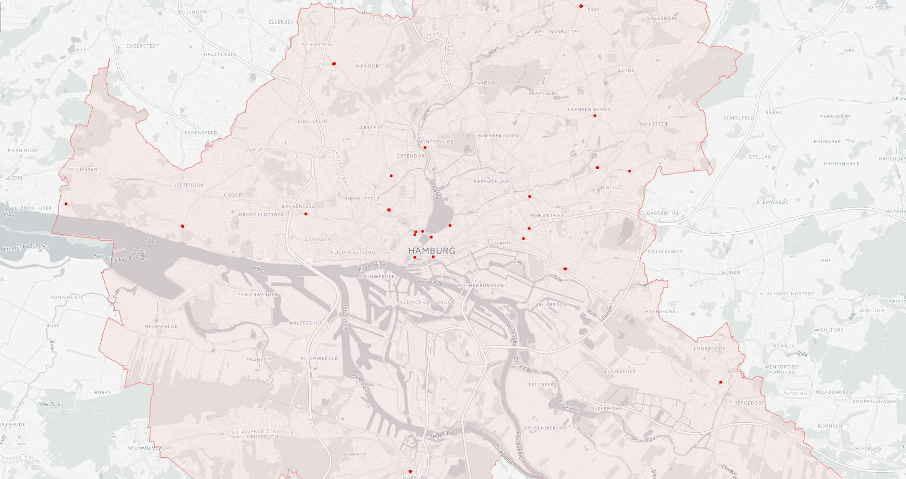
Manual bike counting at 38 locations each Year

Slide 4
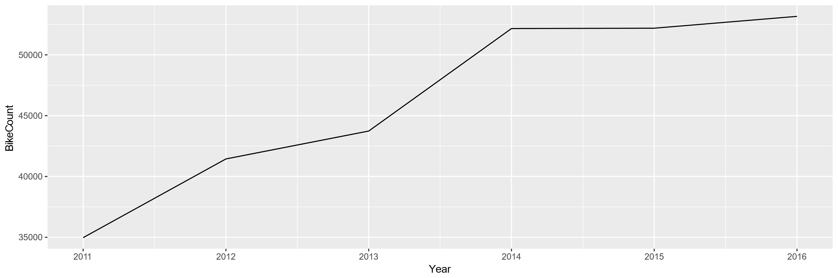
Aggregated data of the 38 measuring locations

Slide 5
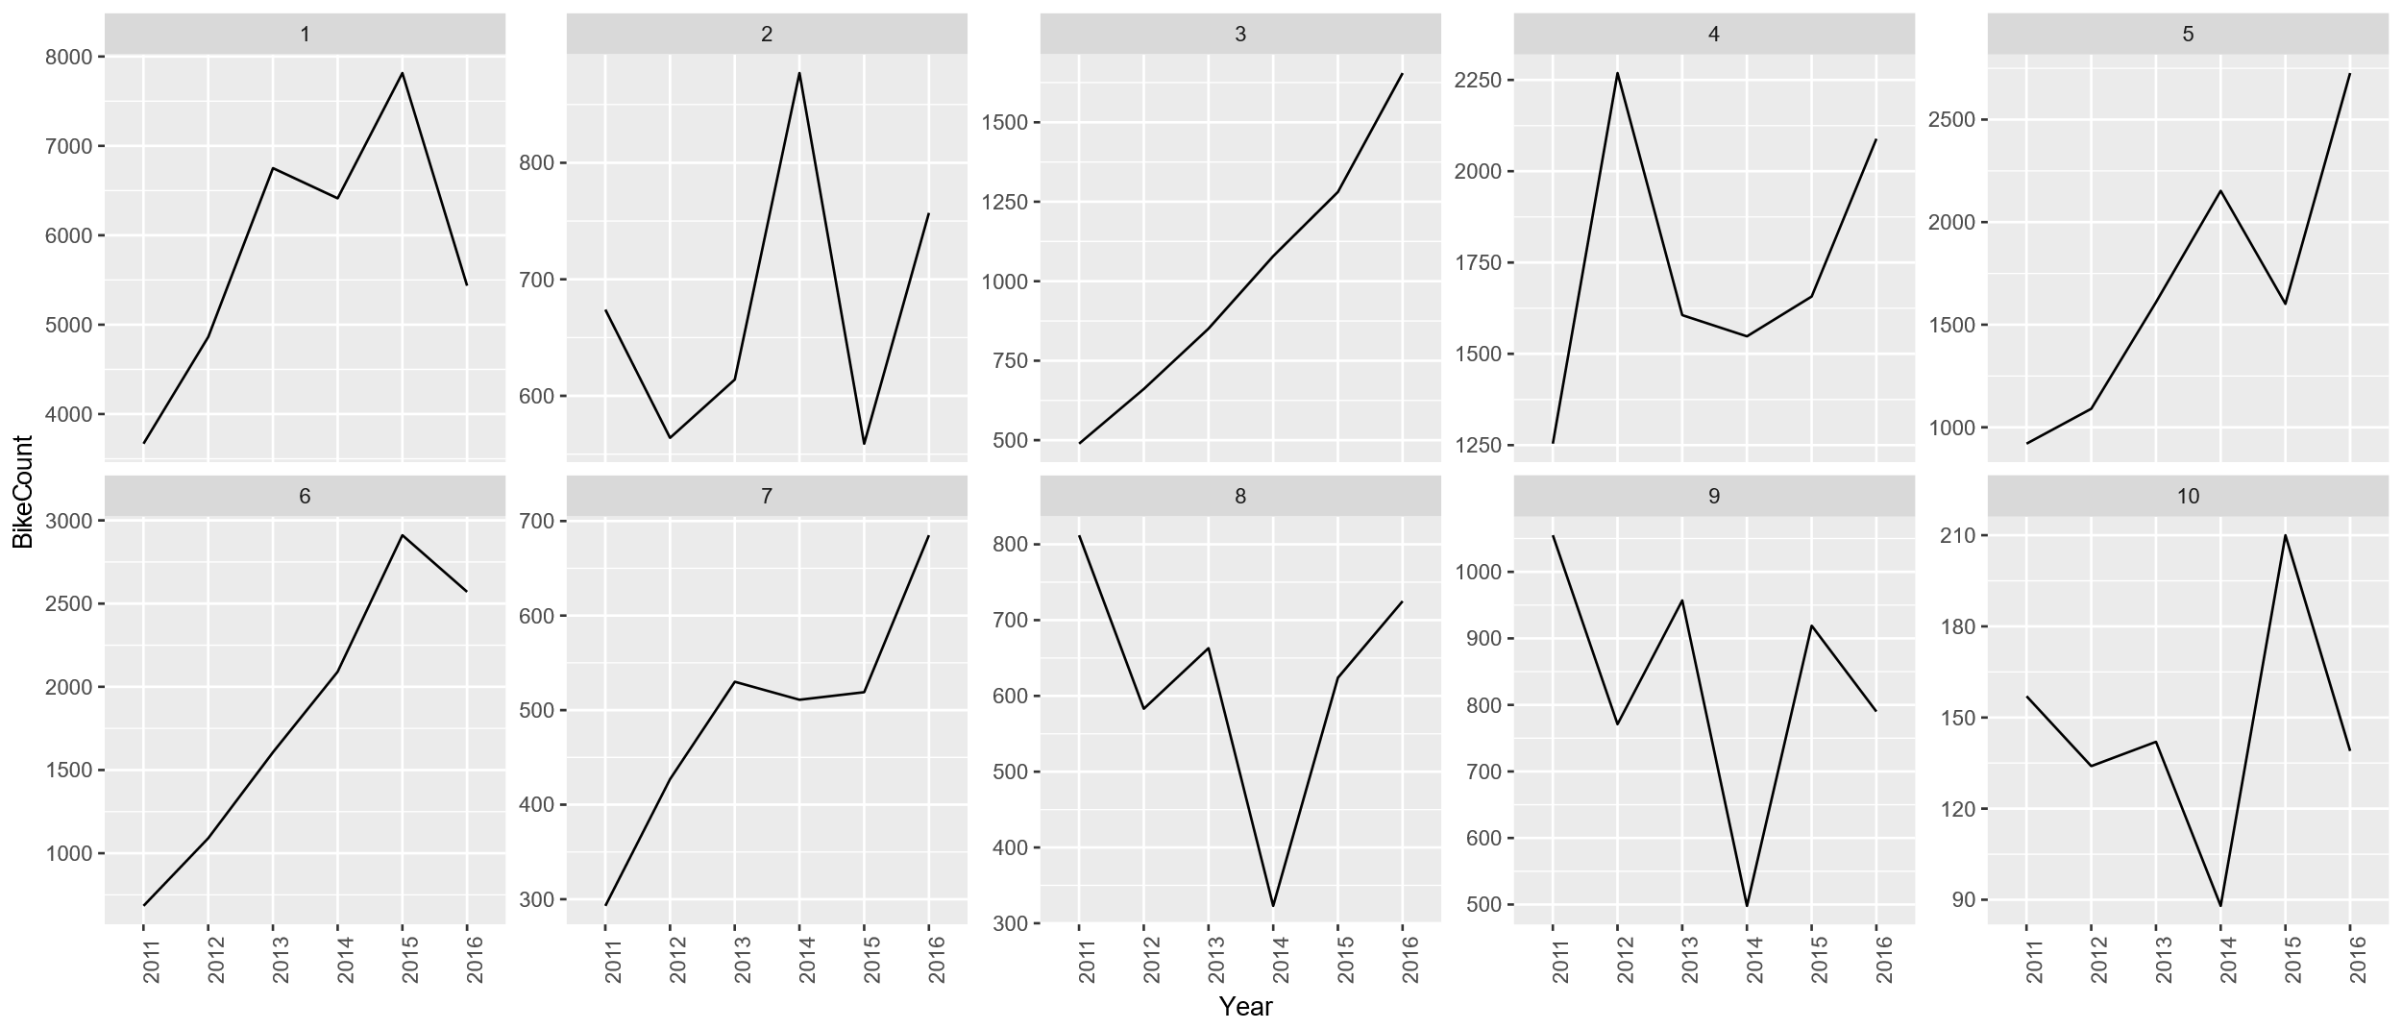
Data of the 38 measuring locations

Slide 6
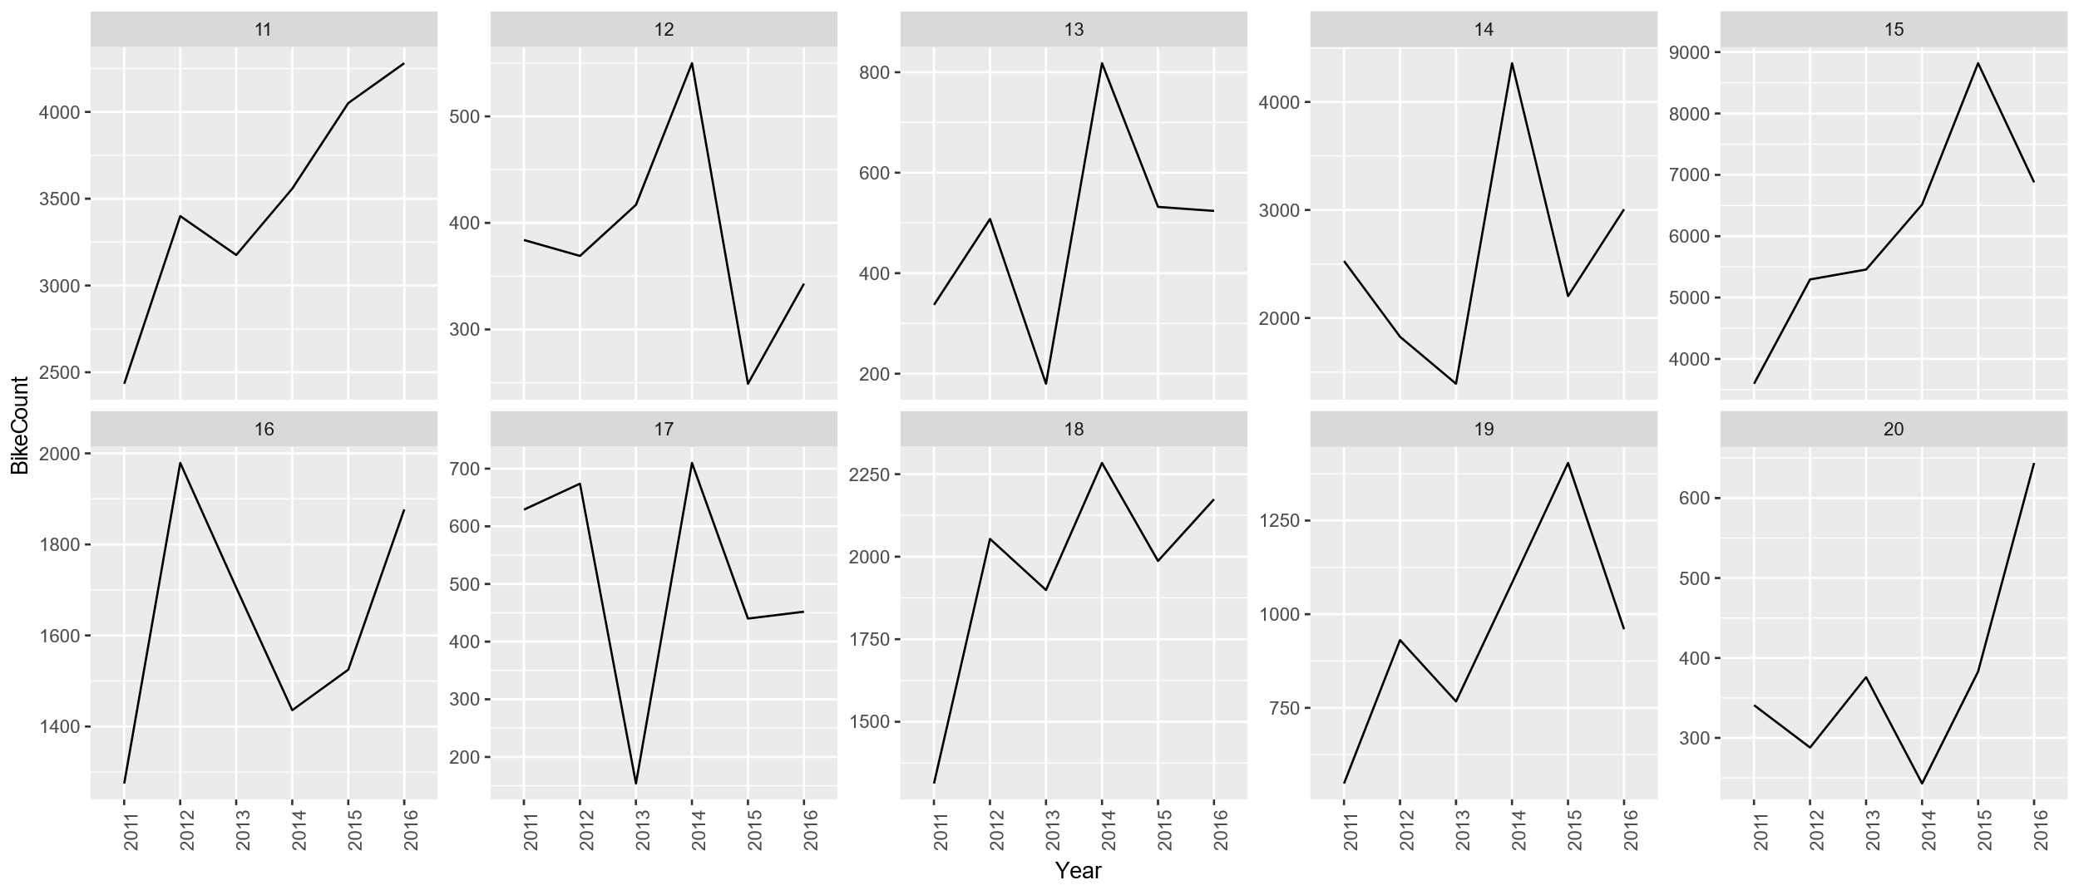
Data of the 38 measuring locations

Slide 7
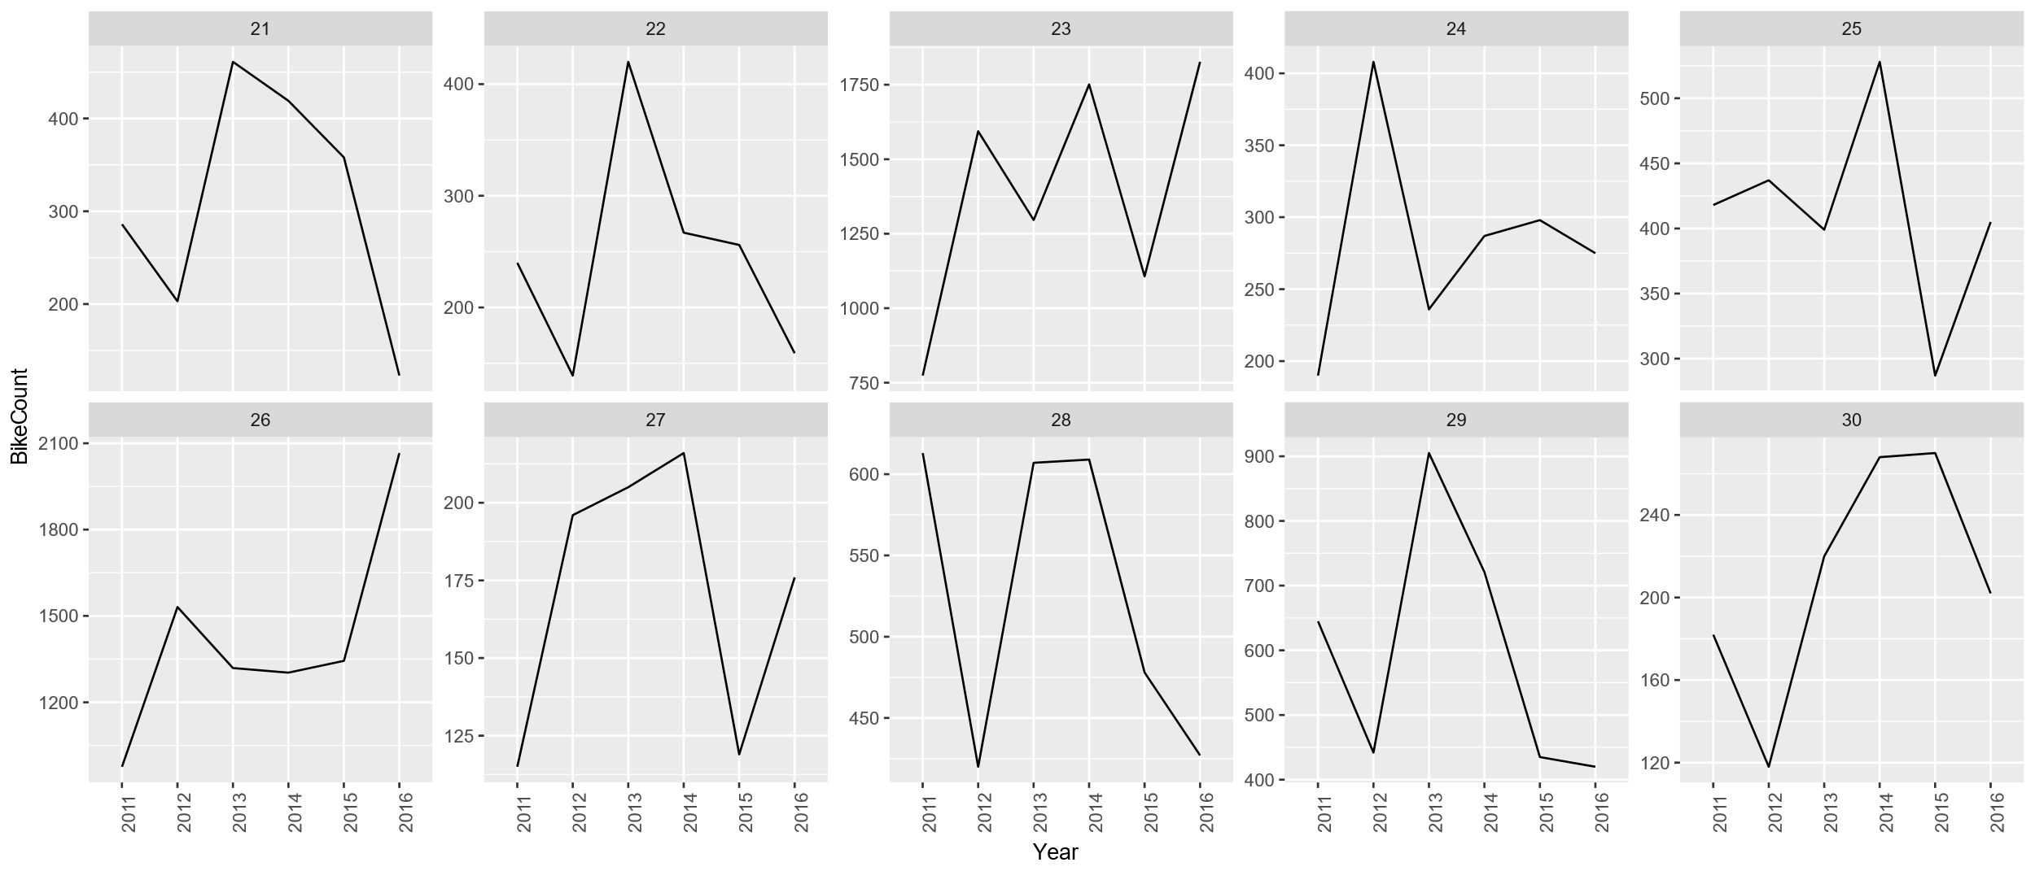
Data of the 38 measuring locations

Slide 8
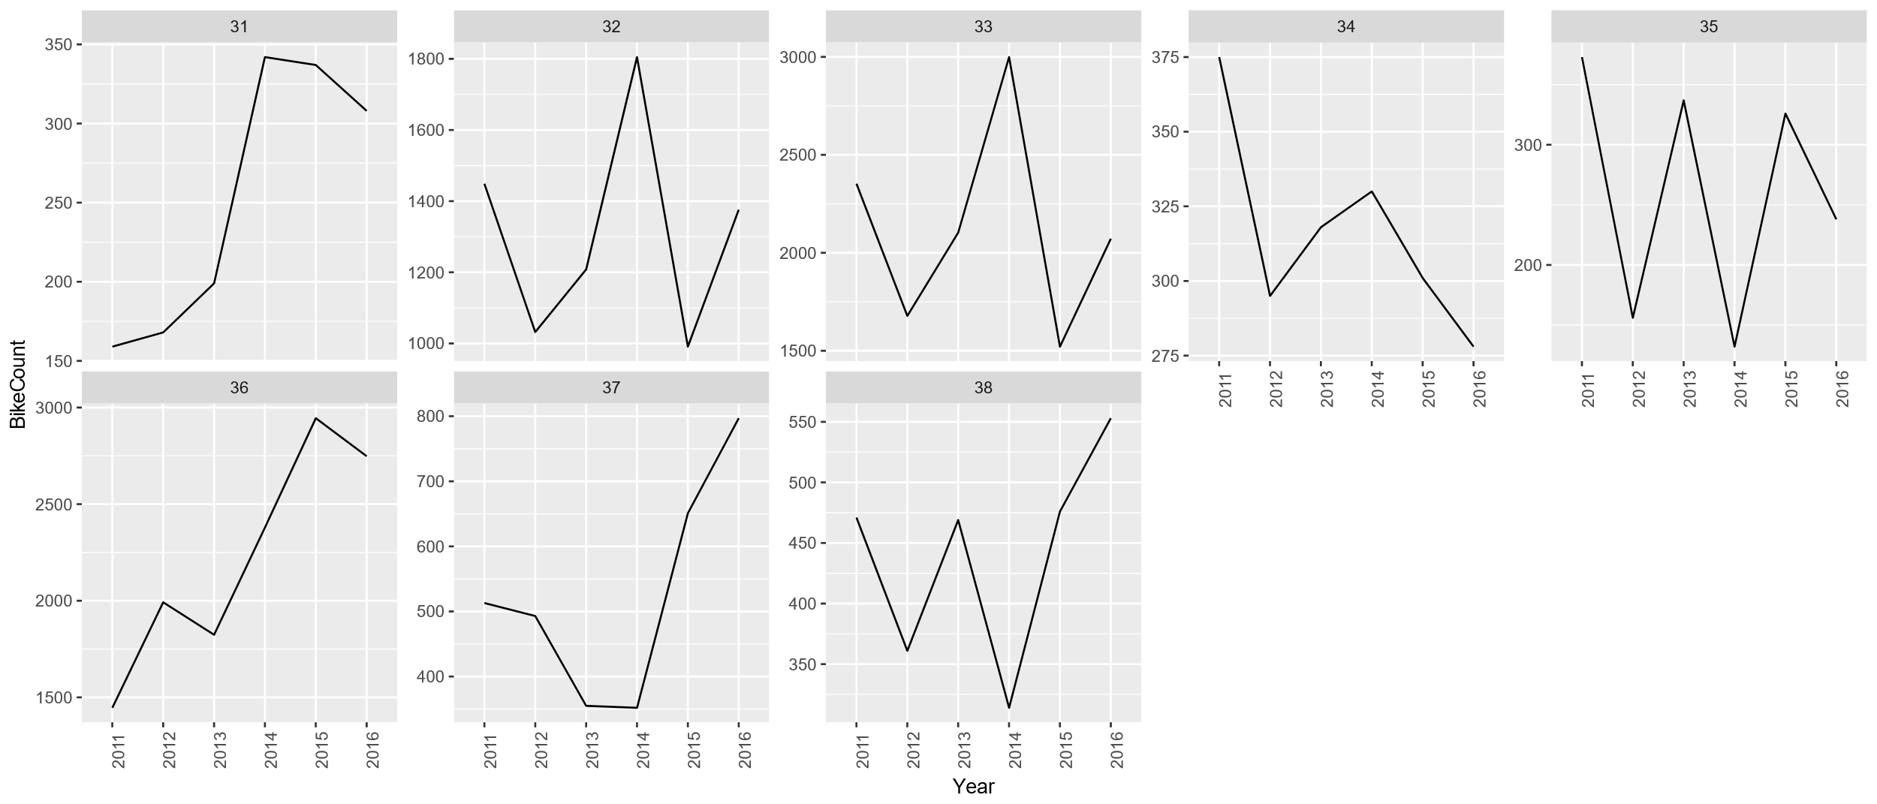
Data of the 38 measuring locations

Slide 9
Why not use Open Data to measure bike usage?

Slide 10
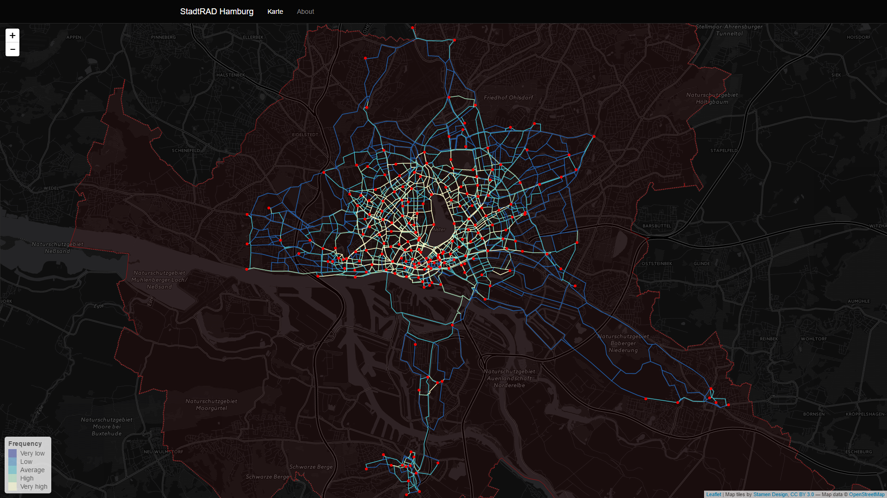
Open Data Sources to measure bike usage: Bike Sharing

Slide 11
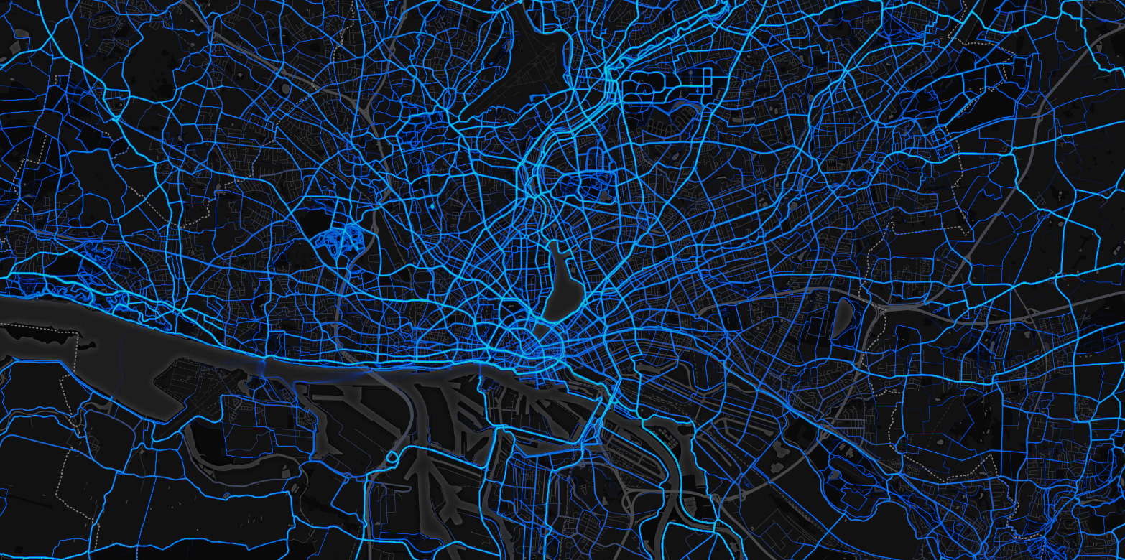
Open Data Sources to measure bike usage: Strava Metro

Slide 12

Questions?
@krusealex2013
kruse-alex

